Slide 1

BMW v. Audi
The Battle for the Staple Luxury Car Brand

Slide 2
Audi
BMW
4.88
4.88
Notes:
Median Rating Edmunds Consumer Ratings

Slide 3
01
Overall Comparison Reviews
02
03
Electric Vehicles
04
Final Thoughts
Overall Comparison Sales

Slide 4

01
Overall Comparison - Reviews
Comparing consumer reviews across 10 years and all models

Slide 5
Data Description
Edmunds Consumer Car Ratings and Reviews
2008-2018
Audi Reviews: 2,060
BMW Reviews: 2,635

Slide 6
Data Description
Edmunds Consumer Car Ratings and Reviews
2008-2018
Audi Reviews: 2,060
BMW Reviews: 2,635
Variables
1 to 5 star rating
Vehicle Title
Model Year
Title of Consumer Review
Consumer Review

Slide 7
Ratings

Slide 8
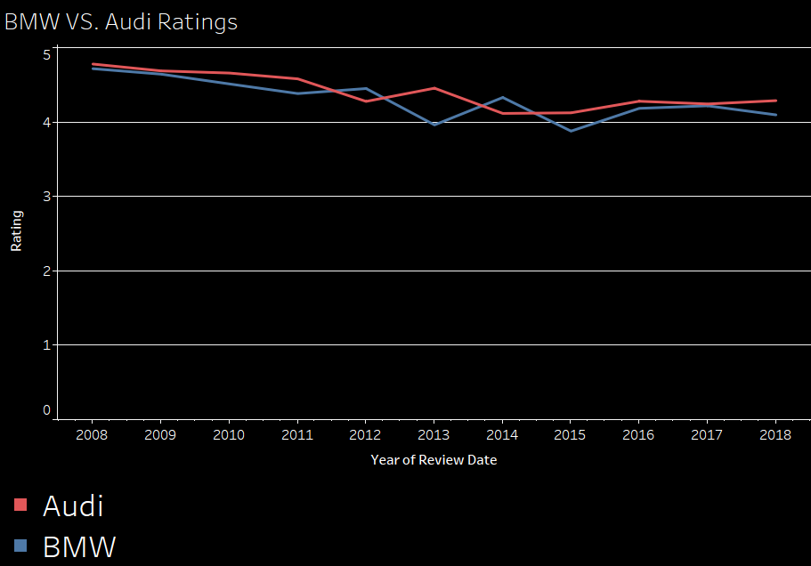
Audi Avg: 4.44
BMW Avg: 4.33
Notes:
There is not a clear cut winner overall with rating… let take a look at the reviews

Slide 9
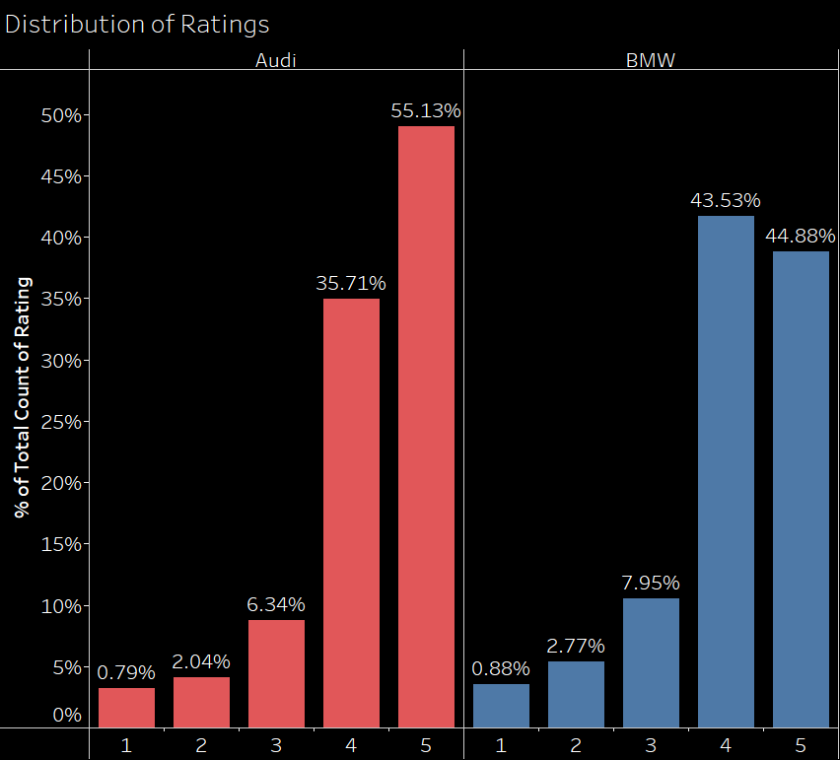
Notes:
Kruskal - Wallis test concluded that the rating is different between the two brands

Slide 11
Reviews

Slide 14
Topic Modeling Review Data

Slide 15

BMW
Pros: 5 Star Ratings
best car ive
car ive owned
absolutely love car
quite turbo efficient
turbo efficient ready

Slide 16
BMW
Cons: 1 Star Ratings
ultimate driving machine
purchased 2011 bmw
total catastrophic failure
check engine light
ill buy bmw

Slide 17
Audi
Pros: 5 Star Ratings
best car ive
car ive owned
audi best car
quiet luxury drive
nicest car ive

Slide 18
Audi
Cons: 1 Star Ratings
oil consumption issue
new engine car
car service department
audi service department
brand new 2018

Slide 19
02
Overall Comparison - Sales
Comparing BMW and Audi sales

Slide 20
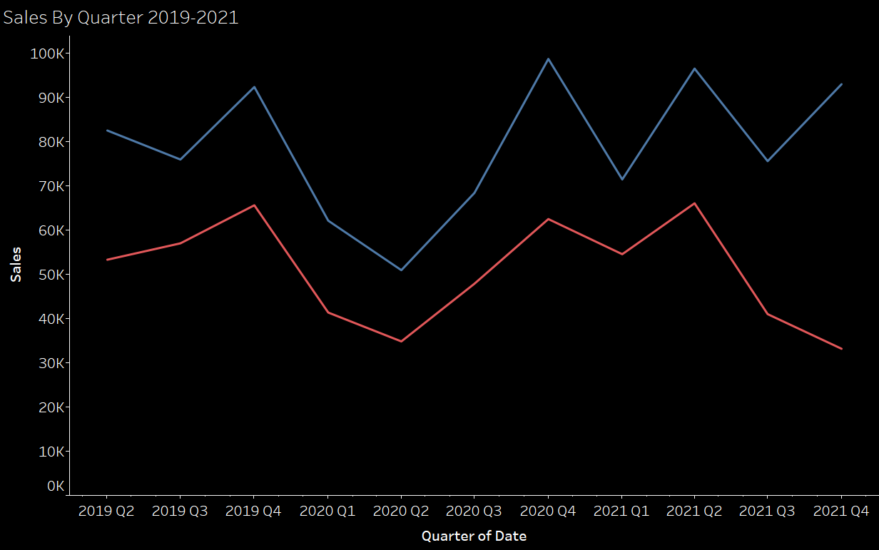
BMW: 78,903 avg cars/qtr.
Audi: 50,678 avg cars/qtr.

Slide 21
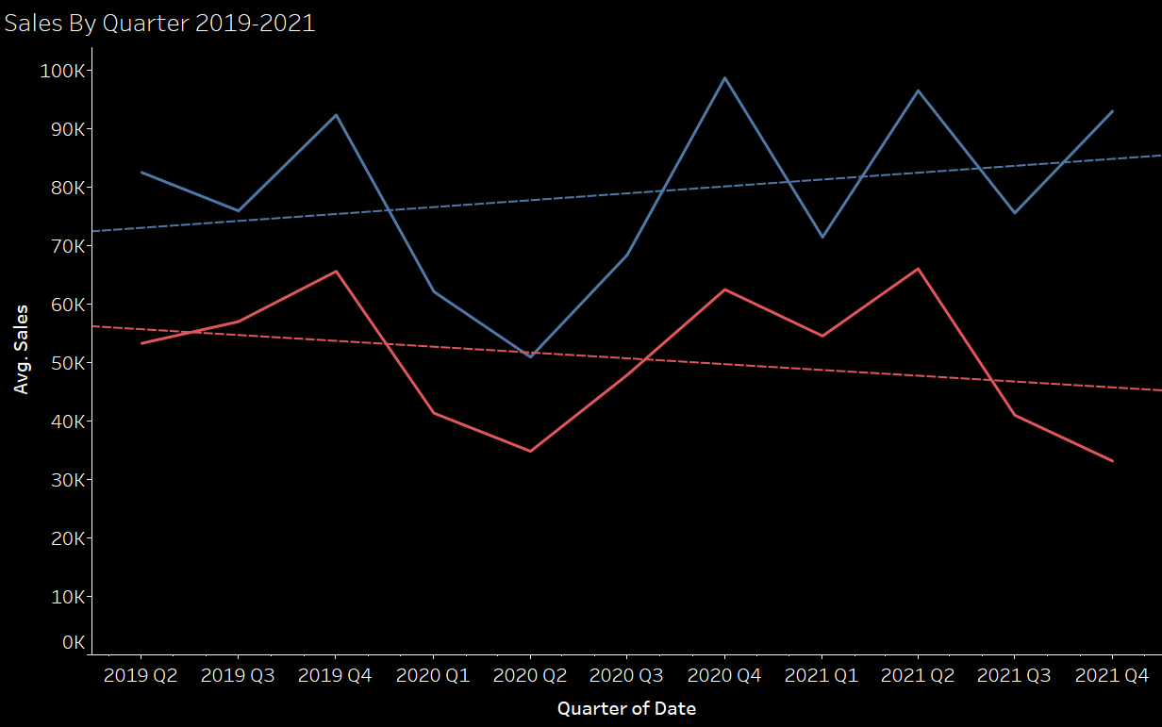

Slide 22
Better Brand According to Sales
BMW

Slide 23
03
Electric Vehicles
The future of luxury cars?

Slide 24
NY Times: Why This Could Be a Critical Year for Electric Cars
“While electric vehicles still account for a small slice of the market — nearly 9 percent of the new cars sold last year worldwide were electric, up from 2.5 percent in 2019, according to the International Energy Agency.”

Slide 25
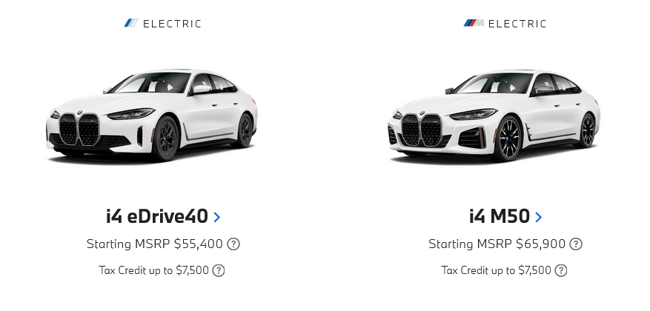
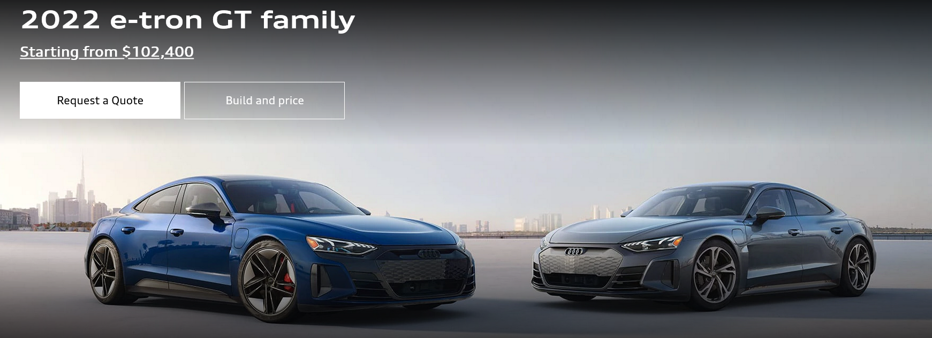
ELECTRIC SEDANS

Slide 26
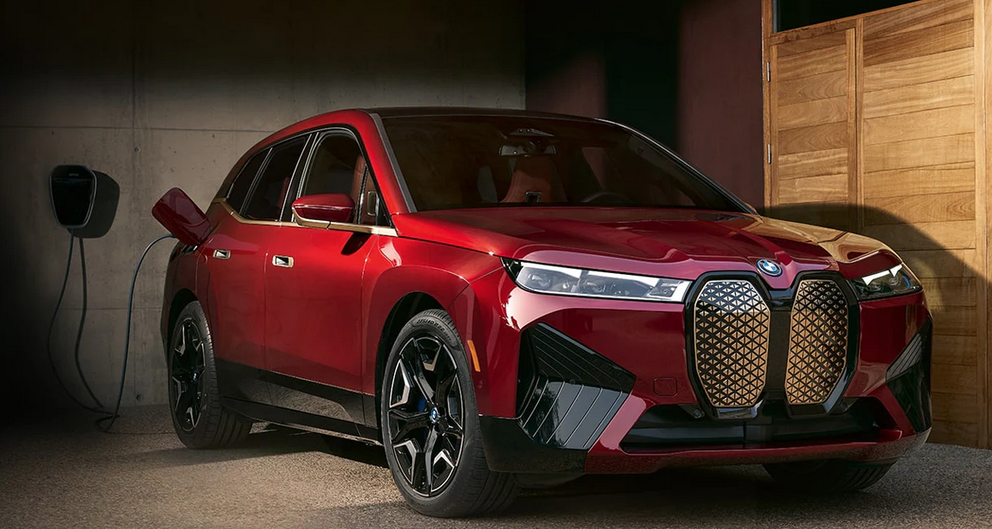
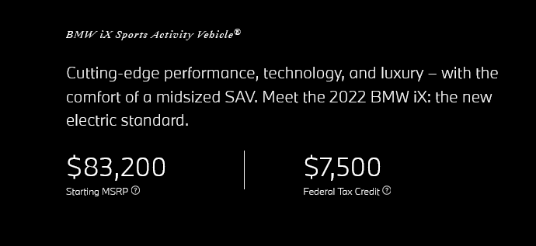
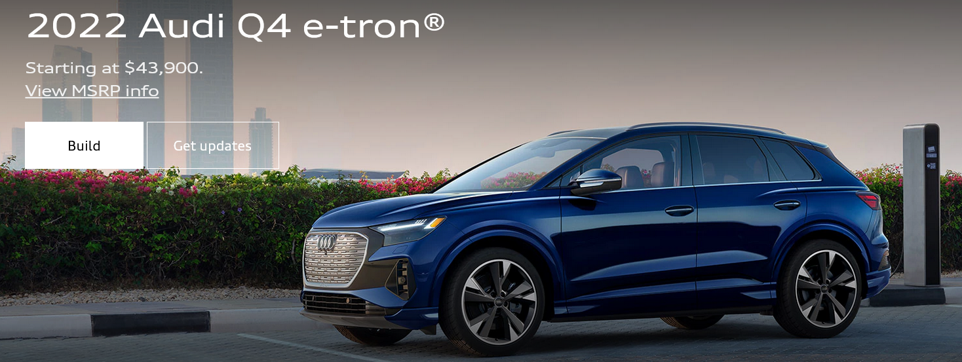
ELECTRIC SUV

Slide 27
Recommendations - Sedan
BMW I4
301 mile max range
335 max hp
Starting MSRP $55,400
Car & Driver Rating: 8.5/10
Audi e-tron GT
238 mile max range
469 max hp
Starting MSRP $102,400
Car & Driver Rating: 8.5/10

Slide 28
Recommendations - Sedan
BMW I4
301 mile max range
335 max hp
Starting MSRP $55,400
Car & Driver Rating: 8.5/10
Audi e-tron GT
238 mile max range
469 max hp
Starting MSRP $102,400
Car & Driver Rating: 8.5/10

Slide 29
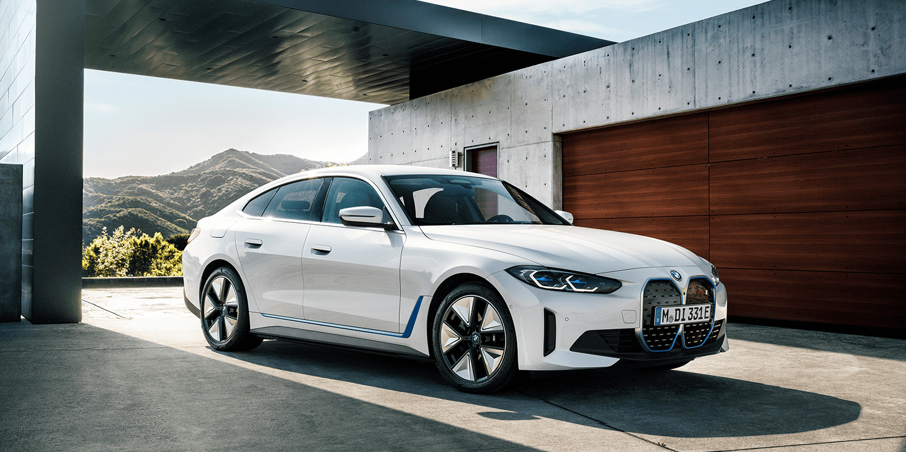
Recommendations - Sedan
BMW I4
301 mile max range
335 max hp
Starting MSRP $55,400
Car & Driver Rating: 8.5/10

Slide 30
Recommendations -SUV
BMW iX
Starting MSRP $83,200
324 mile max range
516 Max hp
Car & Driver 8.5/10
Audi Q4 e-tron
Starting MSRP $43,900
241 mile max range
295 Max hp
Has not been rated yet

Slide 31
Recommendations -SUV
BMW iX
Starting MSRP $83,200
324 mile max range
516 Max hp
Car & Driver 8.5/10
Audi Q4 e-tron
Starting MSRP $43,900
241 mile max range
295 Max hp
Has not been rated yet

Slide 32
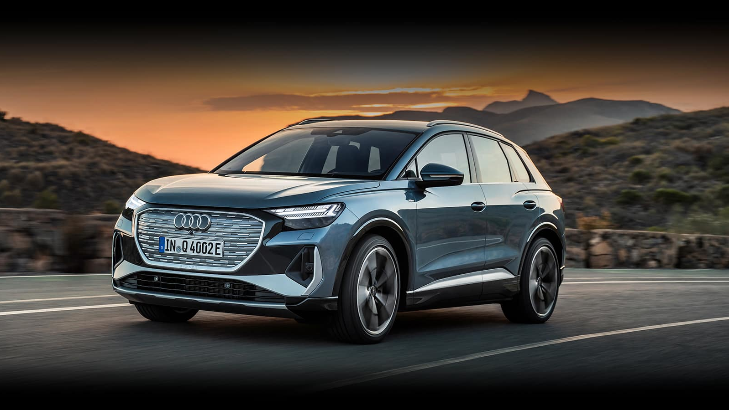
Recommendations -SUV
Audi Q4 e-tron
Starting MSRP $43,900
241 mile max range
295 Max hp
Has not been rated yet

Slide 33
04
Final Thoughts
Is there a clear winner?

Slide 34
?

Slide 35
Appendix
Sales data
https://www.goodcarbadcar.net/2022-us-vehicle-sales-figures-by-brand/
Review data
https://www.kaggle.com/ankkur13/edmundsconsumer-car-ratings-and-reviews
Slides
https://slidesgo.com/

